Slide 1
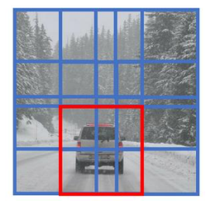
Object detection
Sliding window
R-CNN(two-stage)
Detect target position (generate bounding boxes)
Classify the target object

Slide 2
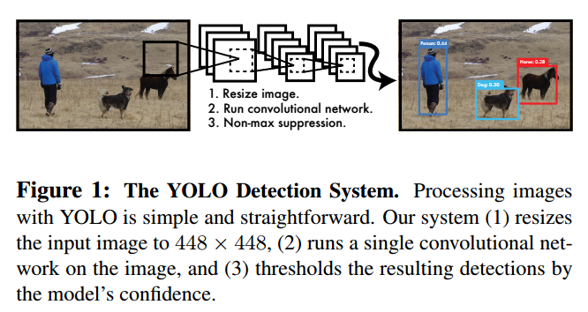
YOLO V1
You Only Look Once: Unified, Real-Time Object Detection

Slide 3
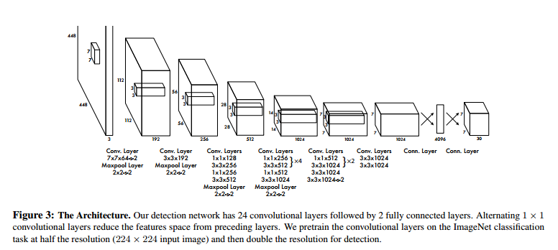
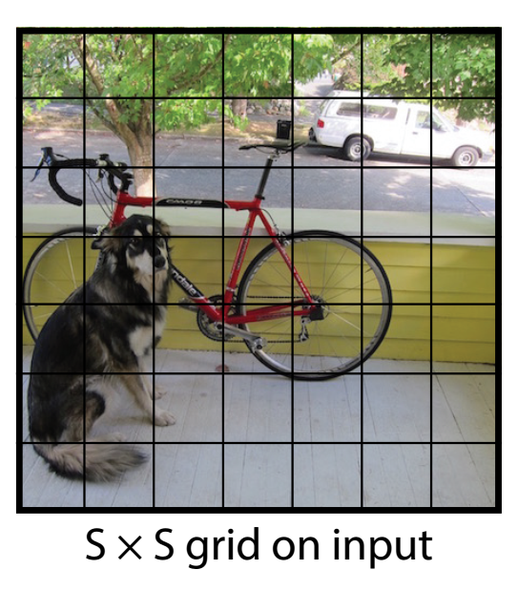
YOLO V1
Inspired by the GoogLeNet
7 × 7
30 = (4 + 1) * 2 + 20
4 + 1 (x,y,h,w) pc
2 bounding boxes
20 classes

Slide 4
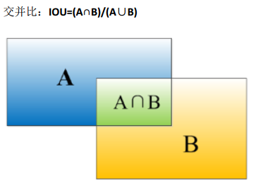
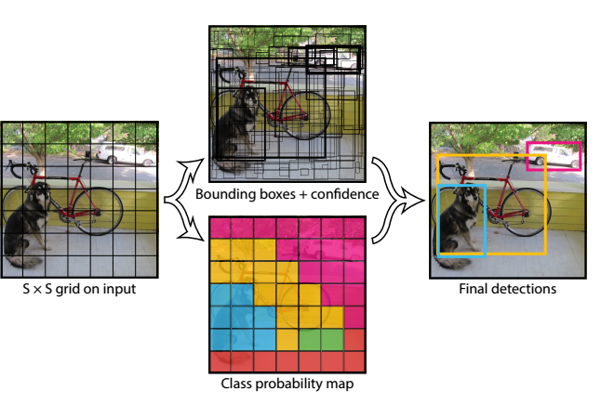
YOLO V1
IOU (Intersection over union)
IOU>0.5
Used in training
Non-max suppression
Each box output{pc,x,y,h,w}
Discard boxes with pc<0.6
While:
Find the largest pc output
Discard IOU<0.5
Notes:
你的算法可能对同一个对象做出多次
检测，所以算法不是对某个对象检测出一次，而是检测出多次。非极大值抑制这个方法可以
确保你的算法对每个对象只检测一次

Slide 5
YOLO V1
Fast: 45 frames per second. A smaller version, fast YOLO, 155 frames per second.
While it can quickly identify objects in images it struggles to precisely localize some objects, especially small ones.
YOLO reasons globally about the image when making predictions. R-CNN mistakes background patches in an image for objects because it can’t see the larger context.
Accuracy is not as good as R-CNN

Slide 6
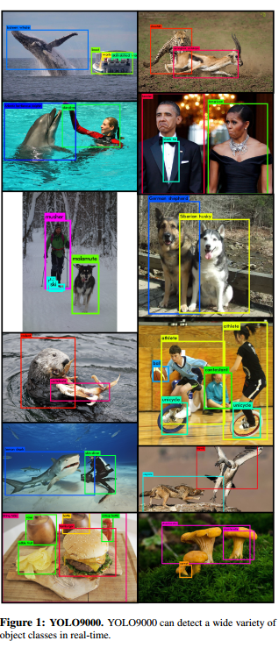
YOLO V2 (YOLO9000: Better, Faster, Stronger)
9000
coco + ImageNet (training on 2 datasets)
Predicts detections for more than 9000 different object categories
Better, Faster, Stronger
Better: A varitey of ideas to improve the performance
Faster: New network----Darknet-19
Stronger: Hierarchical classification.

Slide 7
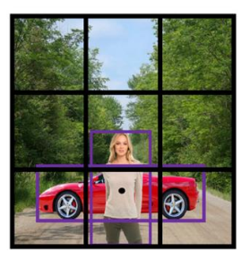
Acher boxes(learning from R-CNN)
Previously:
Each object in training image is assigned to grid cell that contains that object’s midpoint
With two anchor boxes:
Each object in training image is assigned to grid cell that contains object’s midpoint and anchor box for the grid cell with highest IOU.

Slide 8
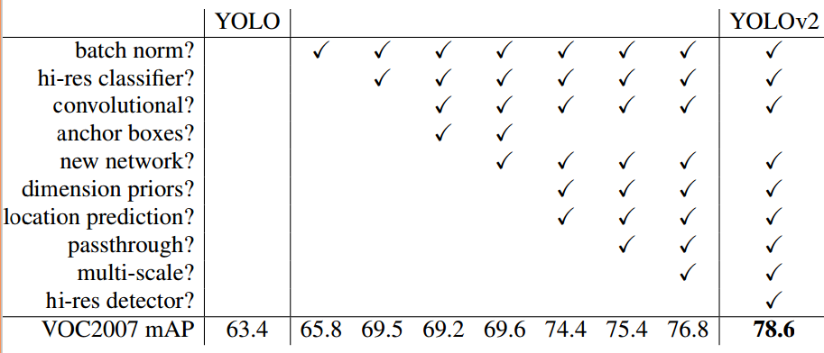
Better
1. Use BN, remove dropout
2. 224*224----->448*448
3. Remove FC using 1*1 convolution
4. The input images can be {32,352,...,608}

Slide 9
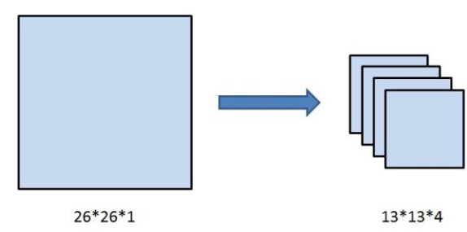
Passthrough
While it can quickly identify objects in images it struggles to precisely localize some objects, especially small ones.

Slide 10
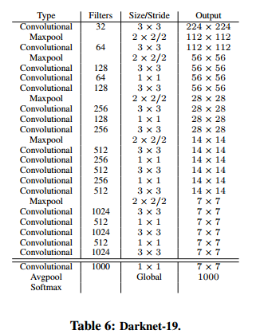
Faster(Darknet-19)
19 convolutional layers and 5 maxpooling layers
Use standard data augmentation

Slide 11
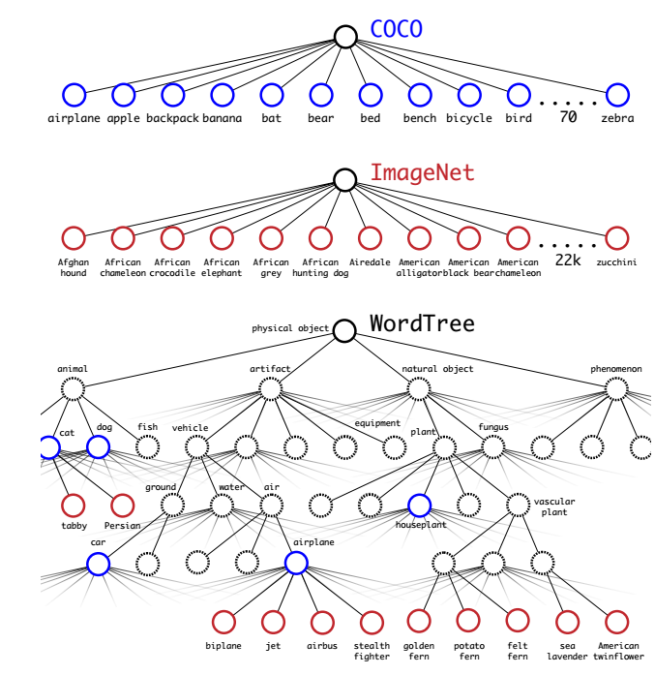
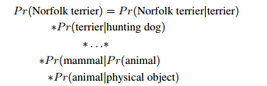
Strong
In coco dataset, there are 80 classes(Dog)
In ImageNet dataset, there are 9000 classes(Many different types of Dogs)

Slide 12
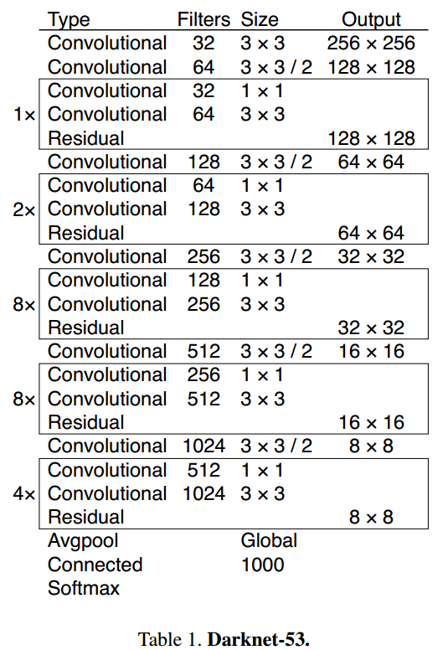

YOLOv3: An Incremental Improvement
Inspired frim ResNet

Slide 13
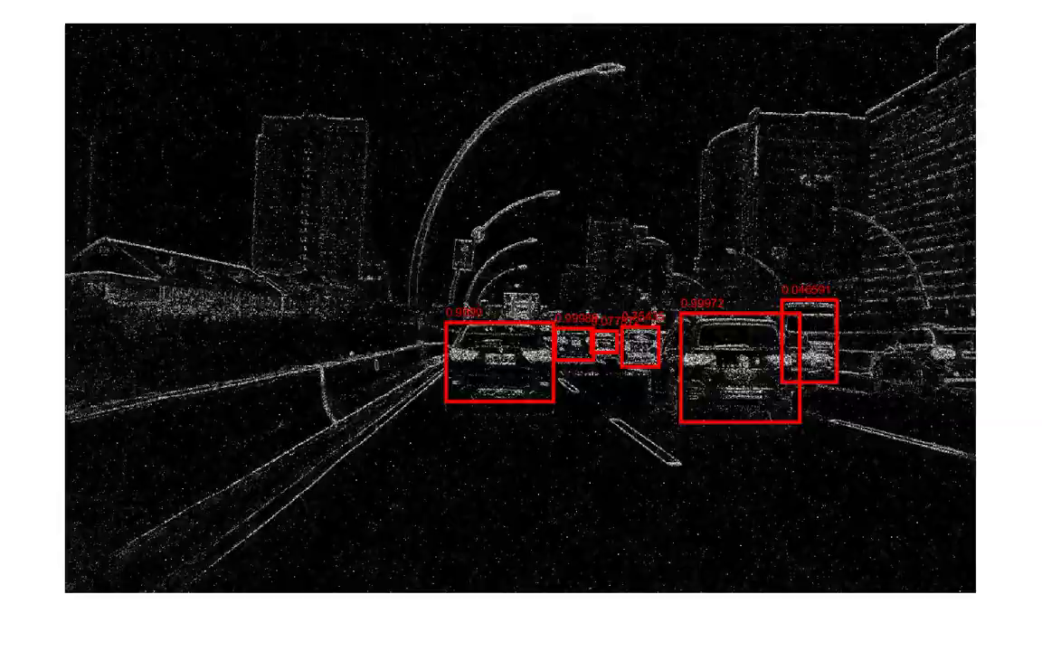
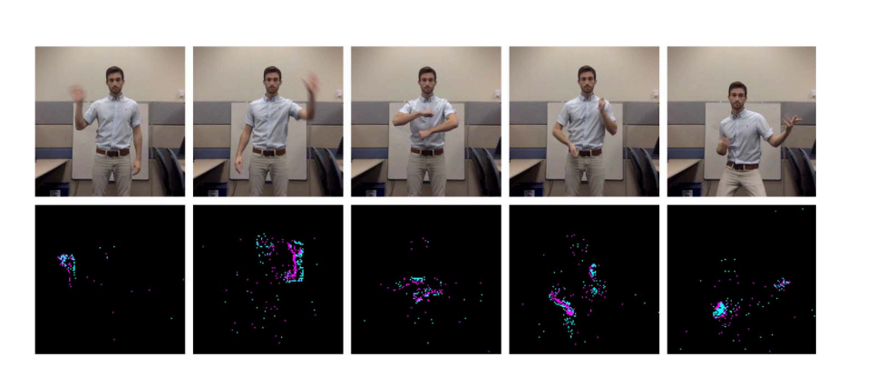
Discuss
基于DVS的目标检测
YOLO+DVS (Object Tracking on Event Cameras with Offline-Online Learning)
DVS+SVM
检测手势动作(人离相机较远时,手是否依然还清晰)
Notes:
https://www.youtube.com/watch?v=2T1730muwVM&feature=youtu.be

